Slide 1
TELEMEDICINE APPLICATION
Team Members
Tejaswi Allam
Keerthi Kamidi
Nikitha Sri Garapati
Asha Noorbasha
Tirumala Arikatla

Slide 2
Project Outline
Introduction
Problem Statement
Use Cases
Functional Requirements
Non Functional Requirements
Architecture diagram/plan
Data management plans
Prototype demos
What has been accomplished?
Spring 2025 plan
Reference-APA

Slide 3

Introduction
Our Telemedicine Application transforms healthcare delivery by providing a safe and user-friendly platform for remote consultations, medical record access, and prescription management. It solves inefficiencies in existing systems by improving access to care, doctor-patient contact, and adherence to medical privacy rules. The app's real-time updates and straightforward design enable people to manage their health easily, removing the need for in-person visits to healthcare facilities.

Slide 4
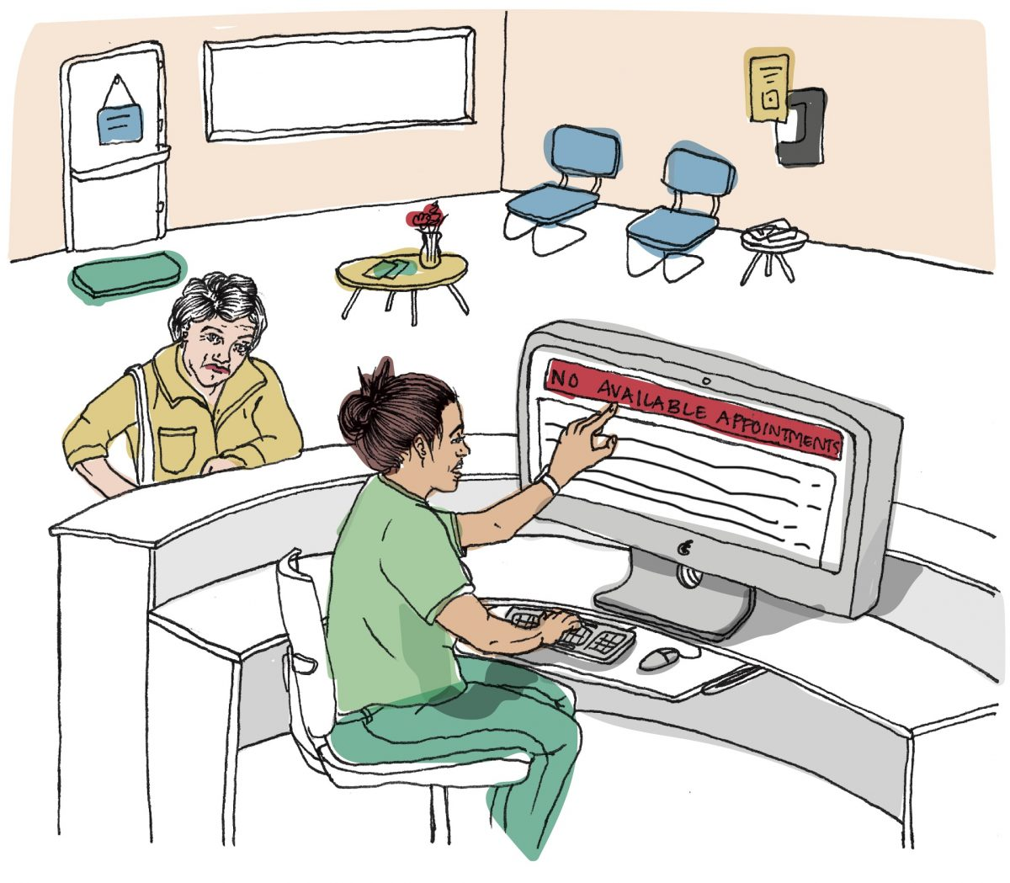
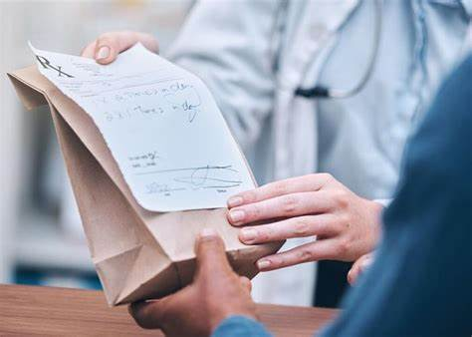


Problem Statement
The existing healthcare system is inefficient and fragmented, often necessitating in-person visits for consultations. This results in long wait times and travel challenges, particularly for individuals with mobility limitations or those residing in remote locations.
Challenges with Medical Records Handling.
Security and lack of unified system
Challenges with Appointments and wait Times
Challenges with Prescription Management

Slide 5
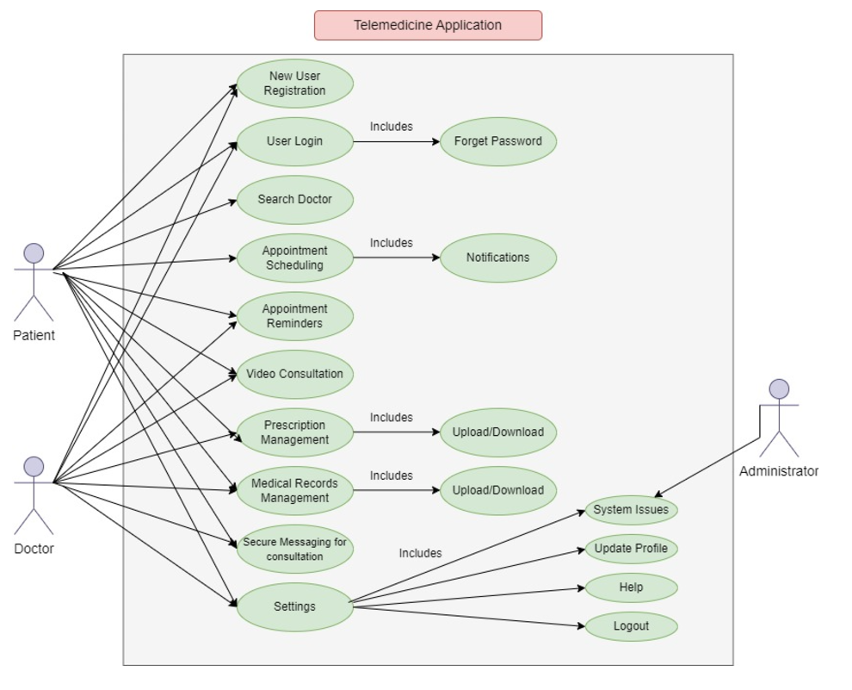
Use Cases

Slide 6
Functional Requirements
Register users as either patients or doctors.
Allow patients to view available doctors and book appointments
Enable patients to cancel or reschedule appointments.
Provide doctors with tools to manage their availability.
Send patients appointment confirmations and reminders.
Real-time video and audio communication
secure storage and access to medical records.
Doctors send digital prescriptions.
Offer a list of nearby or partner pharmacies.
Insurance verification and claims.
General feedback on the app experience.
Include pharmacy integration.
Patients to pay consultation fees through integrated payment gateways.
In-app access to frequently asked questions and support articles.
Not allow any form of data transmission that is not encrypted.
Not allow any features or practices that allow unauthorized access to sensitive user data
SYSTEM MUST
SYSTEM MAY/SHOULD/NOT

Slide 7
Non Functional Requirements
Must be scalable to accommodate an increasing number of users, consultations, and appointments
Ensure automatic synchronization of data across all devices in real-time
Performance
Data consistency
Security
Scalability
Usability
Seamless Video Streaming
Rapid Processing
24/7 Accessibility
Encrypted Video Calls
Secure Messaging Platform
HIPAA-Compliant Privacy
Multi-Factor Authentication
User-Friendly Patient Interface for Appointment bookings,etc.

Slide 8
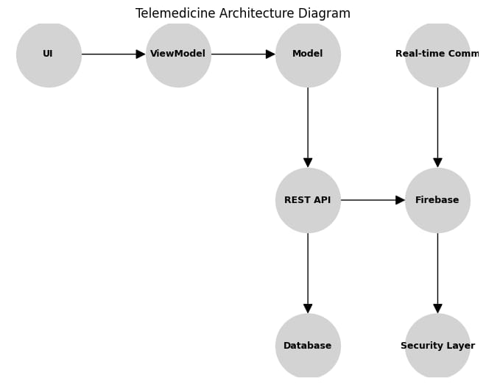
Architecture Plan

Slide 9
Architecture Plan
User Interaction: Actions like login or scheduling start at the UI and pass through the ViewModel to the Model.
Backend Processing: The Model interacts with the REST API, which communicates with the Database, Firebase, and Security Layer to process the request.
Real-Time Features: Video or chat features utilize the Real-time Communication and Firebase modules.
Data Updates: The Database stores and retrieves information, ensuring the application maintains accurate data.
Notifications: Firebase sends real-time updates to the user for reminders or alerts

Slide 10
Platforms/Third-party Libraries/Hosting Strategy
PLATFORMS | THIRD-PARTY LIBRARIES | HOSTING STRATEGIES
Backend Development: Node.js, Postman | Real-time Communication : Send bird or WebRTC: For enabling audio/video calls and chat functionality. | Hosting Platform : Render, Low-cost VPS (e.g., Digital Ocean, Linode):
Frontend Development: Android Studio | Email Notifications: Google Mail (free) or SendGrid (paid): To send appointment confirmations, reminders, and notifications. | Deployment Requirements :The backend application, database server, and real-time communication modules will be deployed together.
Database: MySQL
IDE: Visual Studio Code (VSCode)

Slide 11
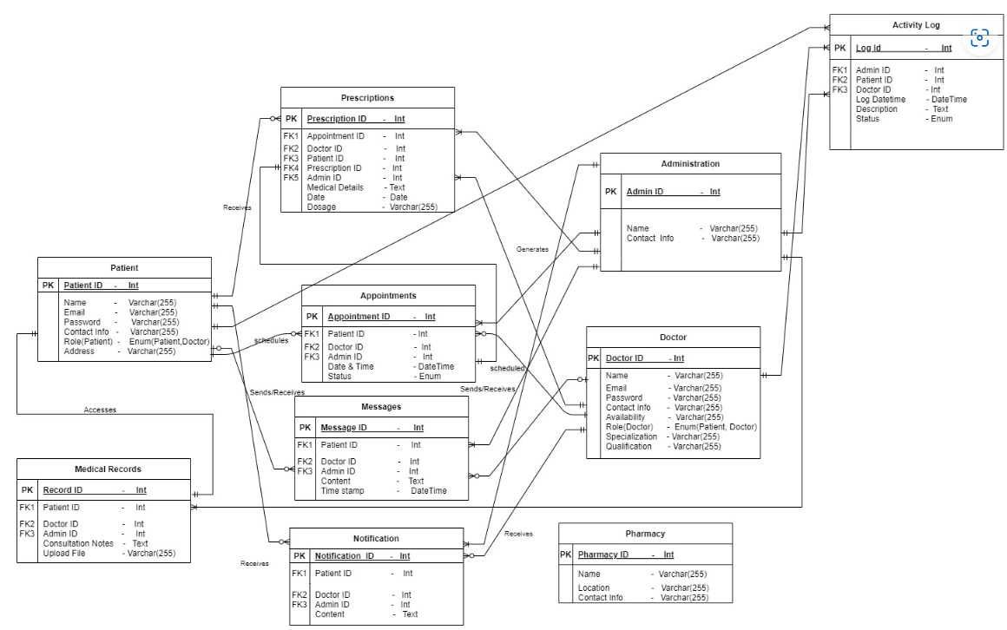
Data Management Plan

Slide 12
Data Management Plan
Initial Plans to Secure Data
Access Restriction:
Implement role-based access control, ensuring patients access only their data and doctors access assigned patient records.
Use Multi-factor Authentication (MFA) for enhanced security.
Encryption:
Secure all data transmission with Transport Layer Security (TLS) to prevent interception and protect user information.
Compliance:
Adhere to regulatory standards like HIPAA by enforcing encryption, audit trails, and strict access control policies.
Database Security:
Restrict database access to authorized services using strong authentication methods like API keys or SSL certificates.
Password Security:
Hash passwords with algorithms like bcrypt or Argon2 and enforce robust password policies (length, complexity, expiration).

Slide 13
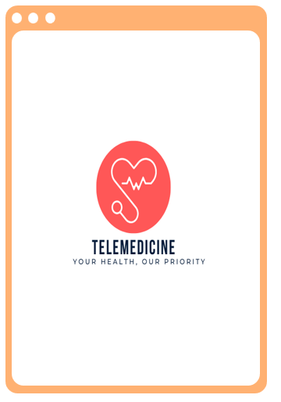
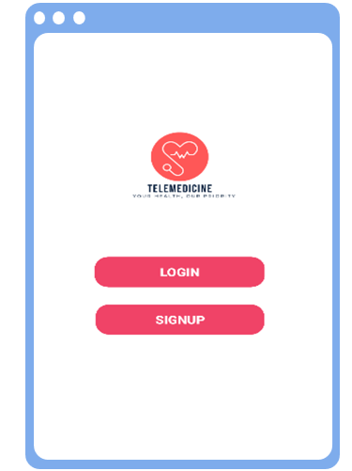
Protype Demos

Slide 14
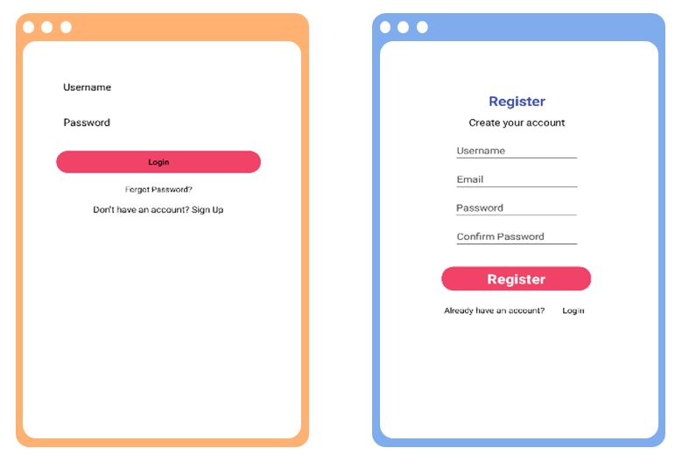
Protype Demos

Slide 15
Functional Prototypes and GUI Mockups
Functional Prototypes/Key Features to be Implemented:
Real-Time Communication
Appointment Booking
Prescription Management
User Role-Based Access
Tools to be Used:
Android Studio:
Used for developing and testing the front-end of the mobile application. GUI elements like forms, buttons, and layouts were created and refined.
Figma:
Utilized for designing GUI mockups and wireframes to visualize user interfaces before implementation.
Provides a clear flow for screens like login, registration, and dashboard.
Postman:
Used for testing backend REST APIs, including user login, appointment scheduling, and prescription management.

Slide 16
Accomplishments
Documented comprehensive functional and nonfunctional requirements, use cases, and prototypes for the telemedicine application.
Designed detailed prototypes showcasing core features such as user login, registration, and dashboard functionalities.
Defined and recorded critical features, including appointment scheduling, video consultations, and prescription management.
Created ER diagrams and flowcharts to clarify system architecture and workflow processes.
Set clear development milestones and timelines to improve project management and tracking.
Conducted thorough research to ensure the application meets industry standards and user expectations

Slide 17
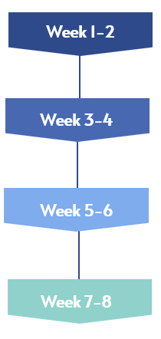
Spring 2025 Plan
Project Kickoff, Create detailed mockups for the UI/UX of the app, Finalize database schema and relationships, Set up Android Studio project and basic folder structure, Set up MySQL database, including initial tables for Users, Appointments, etc.
User Authentication & Registration, Implement the Login and Registration screens in Android Studio, Implement API endpoints ,Implement MySQL queries for user creation and authentication.
Appointment Scheduling, Implement the patient and doctor dashboards, Develop the appointment scheduling screen, Implement API for searching doctors by name, specialization, and location.
Video Consultation & Real-Time Communication, Implement video consultation UI,Integrate video calling functionality, Design and implement a simple chat interface, Begin testing video call functionality in isolated scenarios.

Slide 18
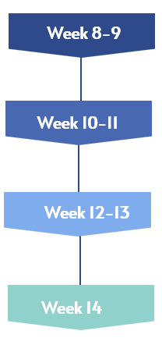
Spring 2025 Plan
Prescription Management & Medical Record Storage, Create the Prescription management screen, Implement medical record upload functionality for patients to upload their reports,test both functionalities.
Secure Messaging & Notifications, Implement the secure messaging interface, Integrate push notifications for new messages, Create endpoints for sending/receiving messages, Test the end-to-end messaging feature
Appointment Reminders & Profile Management, Implement appointment reminders, Create user profile management screens, Create APIs for updating user profiles,Test reminder functionality.
Final Testing & Deployment, Finalize UI/UX elements and address any design issues, Ensure smooth navigation between screens.

Slide 19
References
Gupta, H., & Khera, A. (2019). Telemedicine and mobile health applications in healthcare delivery. Journal of Health Informatics, 26(3), 5-15. https://doi.org/10.1007/s12345-019-0041-0
Muehlbradt, T., & Misra, S. (2020). WebRTC and its integration into telemedicine for real-time communication. Journal of Telemedicine and Telecare, 26(7-8), 424-430. https://doi.org/10.1177/1357633X20944190
Sadiq, M. I., & Bhatti, I. H. (2018). Android application development using Android Studio for beginners. Software Engineering Research Journal, 13(4), 12-19. https://doi.org/10.1016/j.serj.2018.06.004
Zhang, Y., & Liu, J. (2022). Enhancing user authentication and security in telemedicine applications: A survey of methods. Journal of Computer Security, 34(6), 473-491. https://doi.org/10.1016/j.jocs.2022.06.002
Kaur, R., & Singh, S. (2020). Firebase cloud messaging for real-time mobile notifications in healthcare applications. International Journal of Cloud Computing and Services Science, 9(2), 95-103. https://doi.org/10.20533/ijcscs.2020.1005

Slide 20
*****THANK YOU*****

